Slide 1
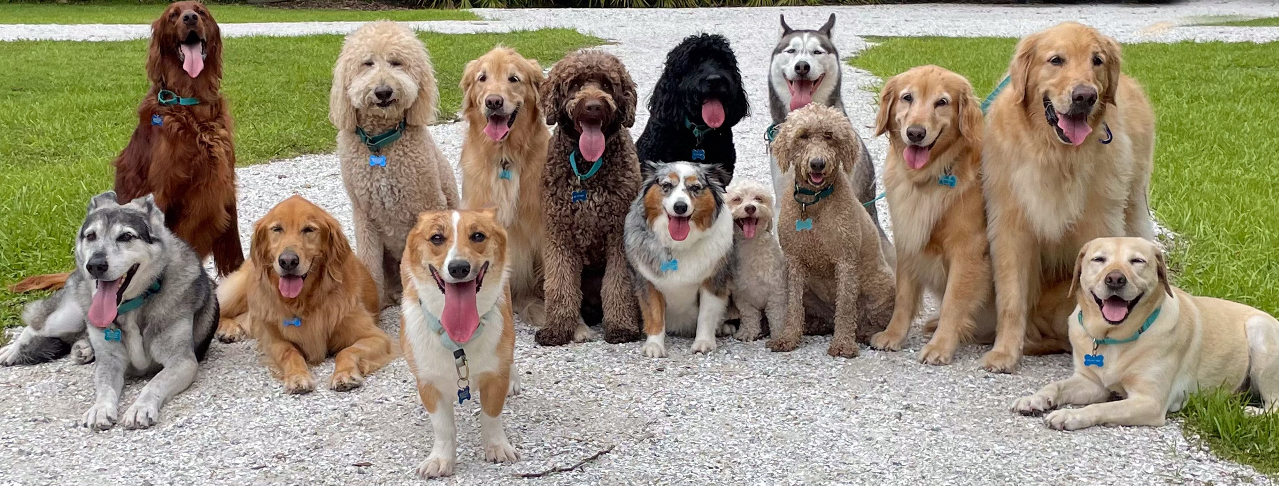
Dog Breeds
By James Doggard

Slide 2
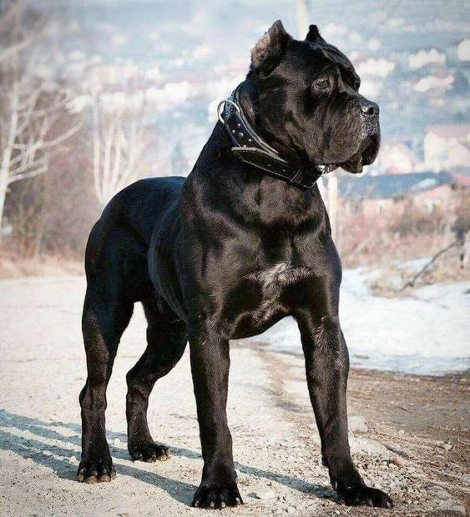
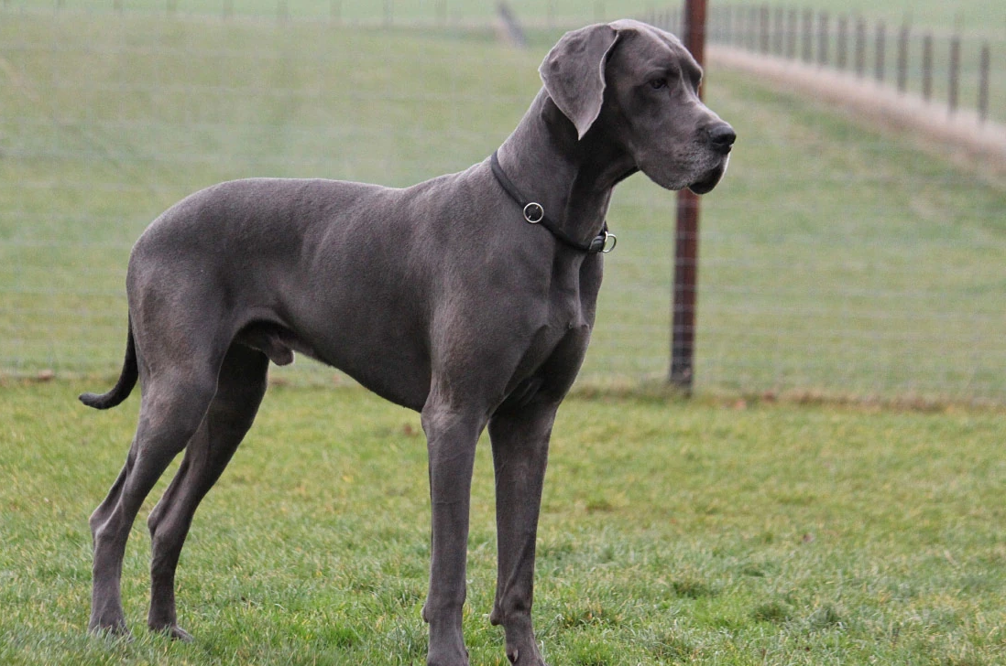
Large Dogs
Great Dane
Cane Corso

Slide 3
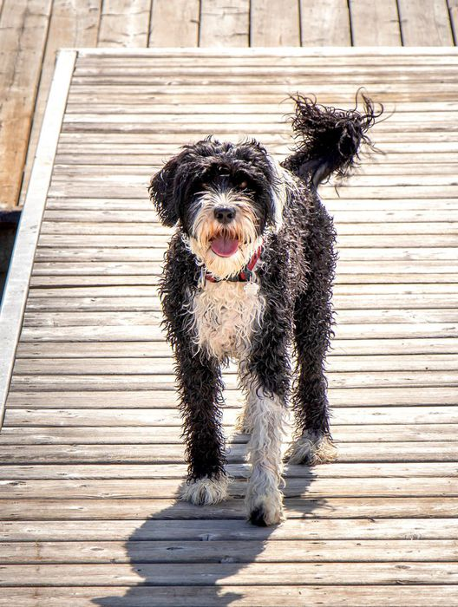
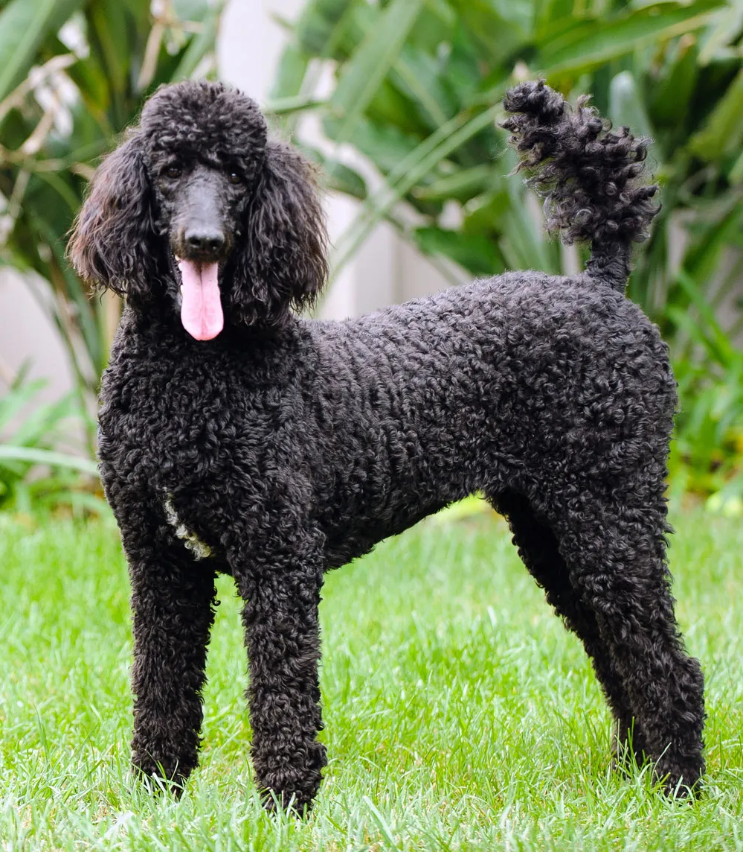
Medium Dogs
Portuguese Water Dog
Poodle

Slide 4
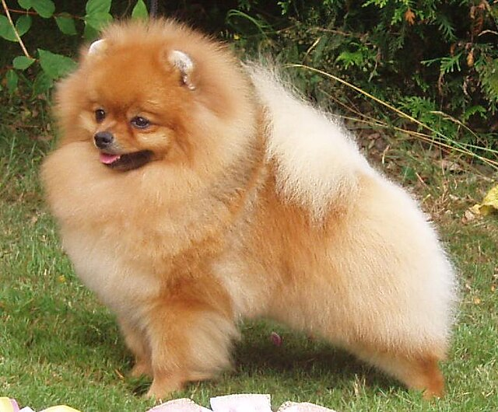
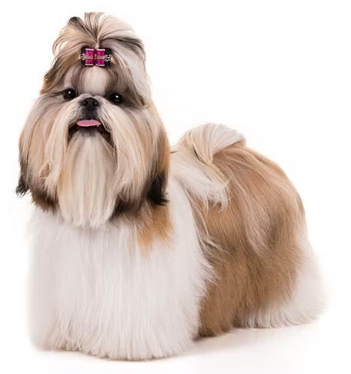
Small Dogs
Pomeranian
Shih Tzu

Slide 5
Adopt Today !!!!!!!

